Slide 1
Unified Modeling Language (UML)
Instructor:

Slide 2
Agenda
After the course, student will:
Understand about UML concepts
Be able to read simple analysis/design UML diagrams
Can analysis overview of the system through symbols of UML such as: actor, events, use case scenario, diagram
Can analysis the activities/processing/ relationship of object in system through symbols

Slide 3
What is UML ?
UML - Unified Modeling Language
Standard & graphical language
Used for software as well as non software
UML is a language (notation) for modeling Object Oriented system
Used for making software blue print
specifying, visualizing, constructing, documenting the artifacts of software system

Slide 4
Why UML?
Graphical notation
A picture is worth a thousand words
Standard communication language
Provides multiple diagrams for capturing different Architectural Views
Promotes component reusability
UML is a standard language for visualizing, specifying, constructing, and documenting software systems

Slide 5
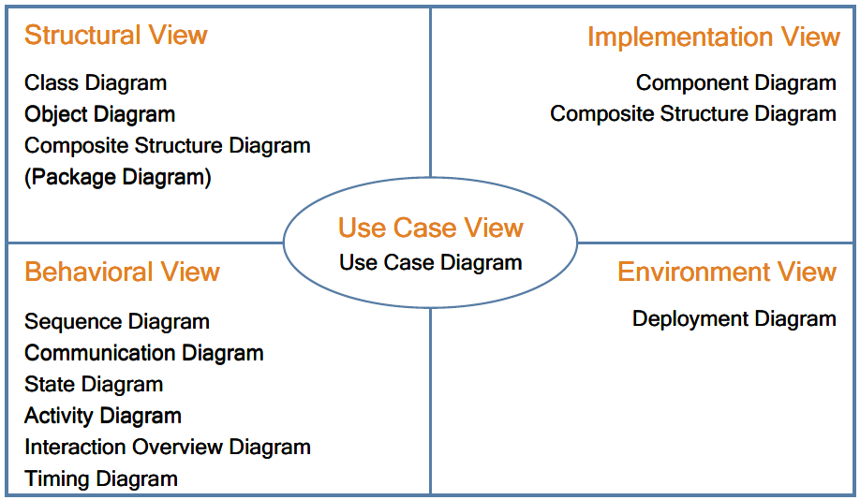
UML Architectural Views and Diagrams
UML defines 13 diagrams that describe 4+1 architectural views
4+1 architectural views model was proposed by Philippe Kruchten, IBM
Notes:
Emphasis that this slide will focus on 4 common used diagrams including Use case diagram, Class diagram, Activity diagram and Sequence diagram.

Slide 6
UML Overview
Structural Things
Class, interface, collaboration,
use case, components, nodes
Class diagram
Object diagram
Component diagram
Deployment diagram
Behavior things
Interaction, State machine
Group things
Package
Structural Diagram
Annotation things
Note
Things
Diagram
Relationship
Use case diagram
Activity diagram
Interaction diagram
State machine diagram
Structural Relationship
Dependency, Aggregation,
Association, Generalization
Behavioral Diagram
Behavior Relationship
Communication, Includes,
Extends, Generalizes
Notes:
Structural things allow the user to describe relationships.
Behavioral describe how things work
Group things are used to define boundaries.
Annotational things are used to add notes to the diagrams
Structural relationships are used to tie the things together in the structural diagrams
Behavioral relationships are used in the behavioral diagram
For example, structural diagram used to describe the relationships between classes.
Behavioral diagrams can be used to describe the interaction between people (called actors in UML) and the things we refer as a use case, or how the actors use the system.
Bold ones are the most commonly used UML diagrams.

Slide 7
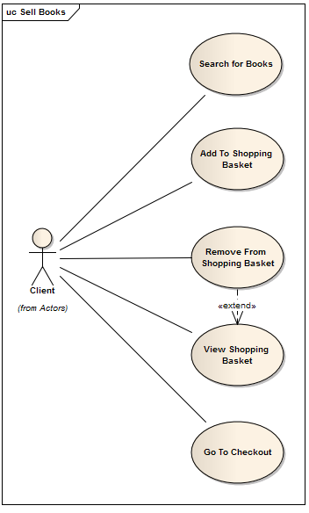
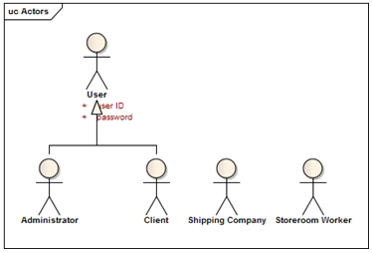
UML – Use case diagram
Describes the functionality provided by system
A Use Case represents a discrete unit of interaction between a user (human or machine) and the system.
Contains actors, use cases, and relationships
BookShop Sample: Actors + Sell Book Use Cases
Notes:
Use case digaram là để mô tả một cách tổng quát chức năng của hệ thống theo actor (một người hoặc một đối tượng nào mà có tương tác với hệ thống) và theo những gì mà actor đó muốn. Hay nói một cách đơn giản là use case diagram cho biết hệ thống có những chức năng, actor nào và chúng liên quan đến nhau như thế nào
A use case diagram, describing how the system is used.
A use case scenario (although technically it is not a diagram) is a verbal articulation of exception to the main behavior described by the primary use case.

Slide 8

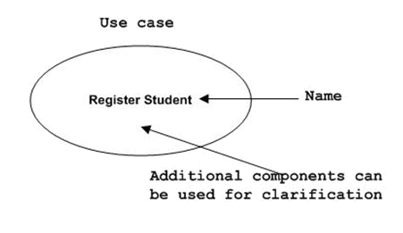
Use case diagram – Structural things
Actor:
Can be human user, internal applications, external application
Use case
High level functionalities of a system

Slide 9
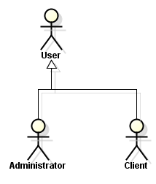
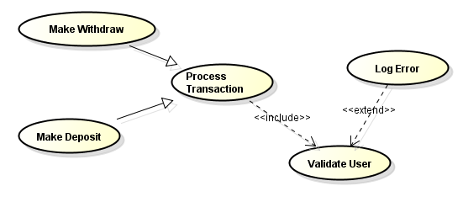
Use case diagram – Relationship
Actor Relationship: Generalization
Used to define overlapping roles between actors
Actor – Use case relationship
Association
Use case Relationship
Include
Extend
Generalization/Specification
Notes:
Actor relationship: generalization: tức là tổng quát hoá: như hình bên: khách hàng và người quản trị hê thống sẽ được tổng quát hoá = 1 actor là người sử dụng. Việc sử dụng relationship này rất hữu dụng khi bạn muốn định nghĩa những chức năng trùng nhau của actor, ví dụ: cả khách hàng và người quản trị hê thống đều phải login và có account/password

Slide 10
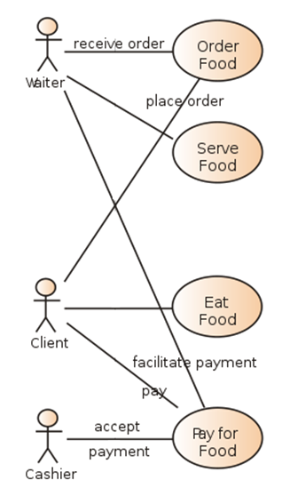
Use case diagram – Association Relationship
Association
Relationship between Actors & use cases
Actor is involved in interaction described by use case
If association line has Arrow head:
Indicate direction of invocation, primary actor
Indicate control flow (not data flow)

Slide 11
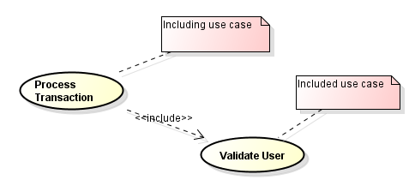
Use case diagram – Include Relationship
Include:
Directed Relationship between 2 use cases
Behavior of the included use case is inserted into the behavior of the including use case
Notes:
Use case relationship: include: use case đầu tiên sử dụng/ phụ thuộc vào kết quả của use case được bao gồm, ví dụ: việc thực hiện giao dịch (Process Transaction) tuỳ thuộc vào kết quả của việc kiểm định người sử dụng
(benefit: use-case duoc included thuong duoc dung chung cho nhieu use-case khac)

Slide 12
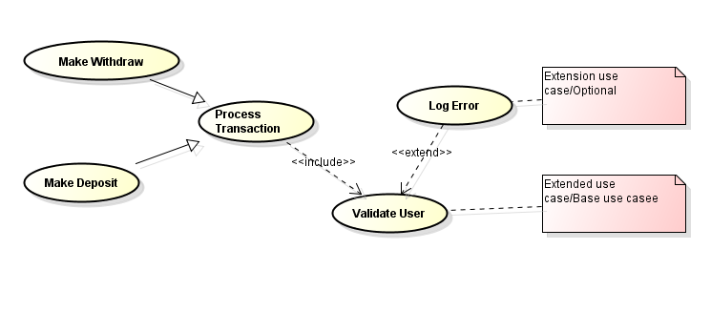
Use case diagram – Extend Relationship
Extends
Behavior of extension use case may be inserted in extended use case under some conditions
Extension use case :
Optional ,
Potentially not executed with the base use case,
Not required to achieve the base use case goal.
Notes:
Use case relationship: extend: cho biết hành vi của một use case được extend (mở rộng) theo một use case khác theo một điều kiện nào đó, ví dụ: việc kiểm định người sử dụng có thể được mở rộng ra một use case Log error (ghi lỗi) nếu account/password không đúng

Slide 13
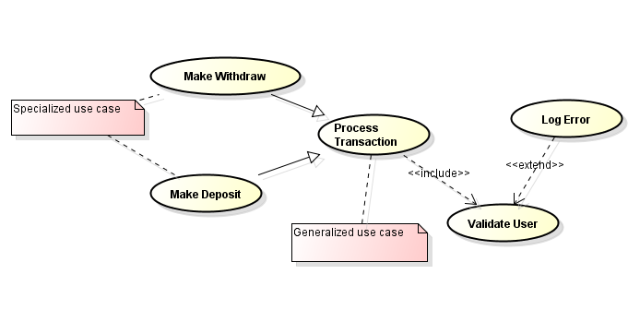
Use case diagram – Generalization Relationship
Generalization/Specialization
Specialized use cases have common behaviors, requirements, constraints, assumptions
Commons are described once in general use case
Differences are described in specialized use case
Notes:
Use case relationship: generalization/specialization: cho biết sẽ có một số use case cụ thể hơn sẽ kế thừa hoặc thêm vào use case đầu tiên, ví dụ: Make withdrawl và Make Deposit là hai use case cụ thể hơn của use case thực hiện giao dịch (Process Transaction)

Slide 14
Use case diagram
To draw use case diagram, identify
Functionalities to be presented as use case
Actors
Relationship among the use cases and actors
Good use case diagram
Name of use case is very important.
Give a name that can identify the functionality to be performed
Give suitable name for actor
Show relationships and dependencies clearly in diagram
Do not include all types of relationship.
Main purpose of use case diagram is to capture requirement
Use note when ever required to clarify some important points

Slide 15
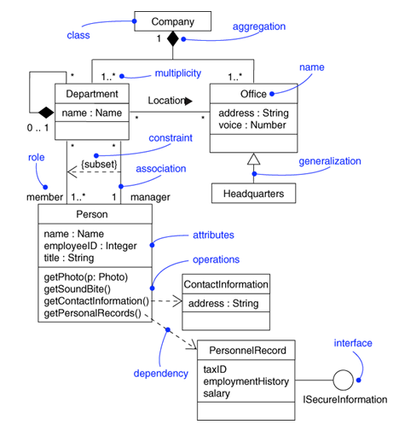
Class diagram
Describe the structure of a system
Show the system's classes, their attributes, and the relationships between the classes.
Purpose:
Analysis and design of the static view of an application
Show the collaboration among the element of a static view
Describe responsibilities of a system
Base for component and deployment diagrams

Slide 16
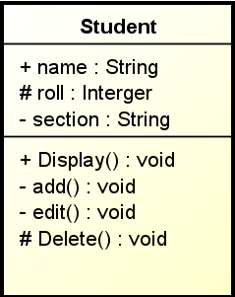
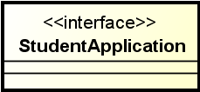
Class diagram – Structural Things
Class
Represent object, having properties and responsibilities
Interface
Used to describe functionalities without implementation
Just like a template
Class implement a template ➔ Implement the functionalities
Class
Name
Visibility
Public
Protected
Private
Attribute
Opertion
Name

Slide 17
Class diagram - Relationship
Instance level relationship
Association
Aggregation
Composition
Class level relationship
Generalization
Realization
General relationship
Dependency

Slide 18
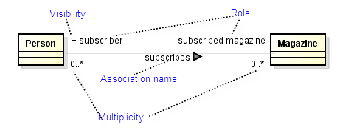
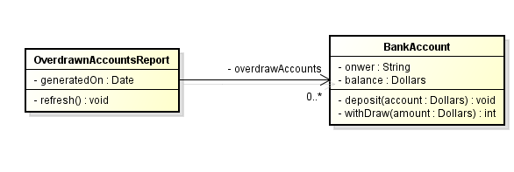
Class diagram – Association Relationship
Represents the static relationship shared among the objects of two classes
Bi-directional:
both classes are aware of each other and their relationship
Uni-directional:
two classes are related, but only one class knows that the relationship exists

Slide 19
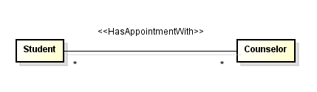
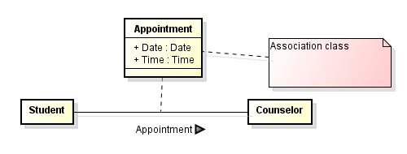
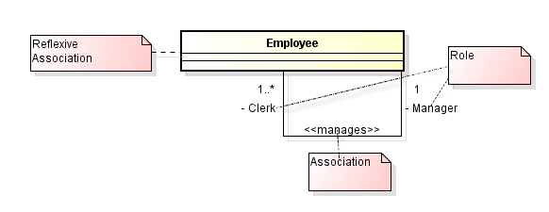
Class diagram – Association Relationship

Slide 20
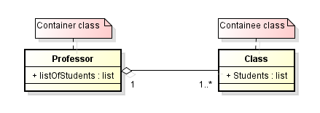
Class diagram – Aggregation Relationship
A type of association
Aggregation – “Has a” relationship
One class is collection or container of another classes
Contained classes do not have strong life cycle dependency on the container
If container is destroyed, contents are not.

Slide 21
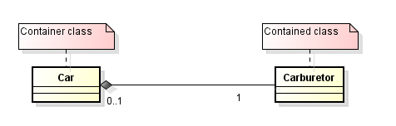
Class diagram – Composition Relationship
Strong type of association
Composition - “owns a” relationship
One class is the collection of another class
Strong life cycle dependency between container objects and contained objects
If container is destroyed, normally every instance that it contains is also destroyed
Notes:
Car “has a” carburetor: composition: một động cơ có một bộ chế hoà khí. Xe mà lao xuống sông thì bộ chế hoà khí cũng tiêu luôn.

Slide 22
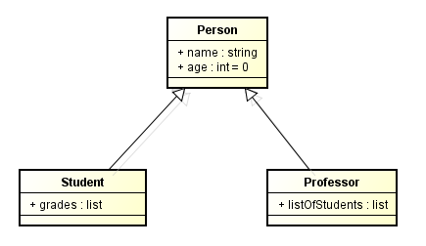
Class diagram – Generalization Relationship
Generalization – Inheritance or “Is a” relationship -
“Professor” is a subtype of Person
“Person” is a generalization of “Student” and “Professor”
Supertype – Super class
Subtype – Sub class

Slide 23
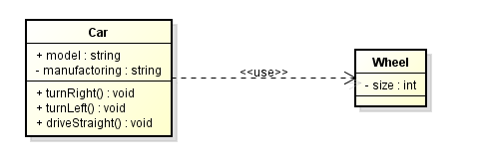
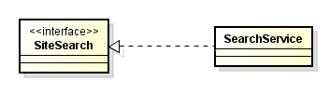
Class diagram – Other Relationship
Dependency Relationship
Weak relationship
One class depend on the other because it use the other
Dependency exists if a class is a parameter variable of a method of another class
Realization Relationship
One model implement/realize the other model
Ex: One class implement the interface defined by other class

Slide 24
Create Good Class Diagram
Name of class, name of diagram should be meaningful to describe the aspect of the system
Element and relationship should be identified in advance
Responsibility (attributes and methods) should be identified in advance
For a class: Minimum of properties should be specified.
Unnecessary properties make class diagram look complicated
Use note when ever required
Diagram may be drawn on plain paper and rework many times to make it correct

Slide 25
Activity diagram (1)
Activity diagrams are graphical representations of workflows of stepwise activities and actions with support for choice, iteration and concurrency.
Activity diagrams show the overall flow of control.

Slide 26
Activity diagram (2)
Activity diagrams are constructed from a limited number of shapes, connected with arrows. The most important shape types:
rounded rectangles represent actions
diamonds represent decisions
bars represent the start (split) or end (join) of concurrent activities
a black circle represents the start (initial state) of the workflow
an encircled black circle represents the end (final state).

Slide 27
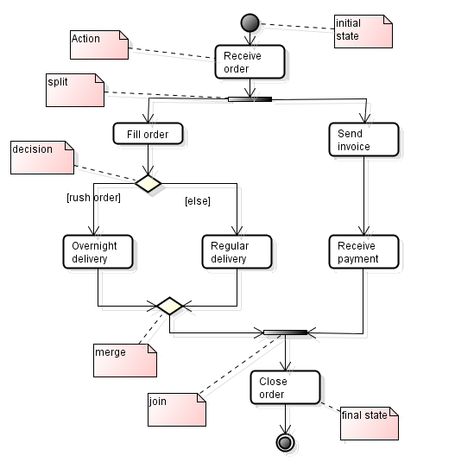
Activity diagram (3)
Example of an activity diagram

Slide 28
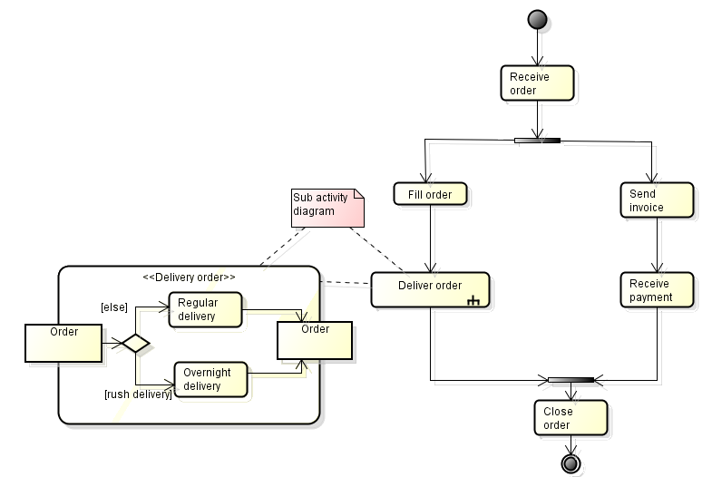
Activity diagram (4)
Sub activity diagram

Slide 29
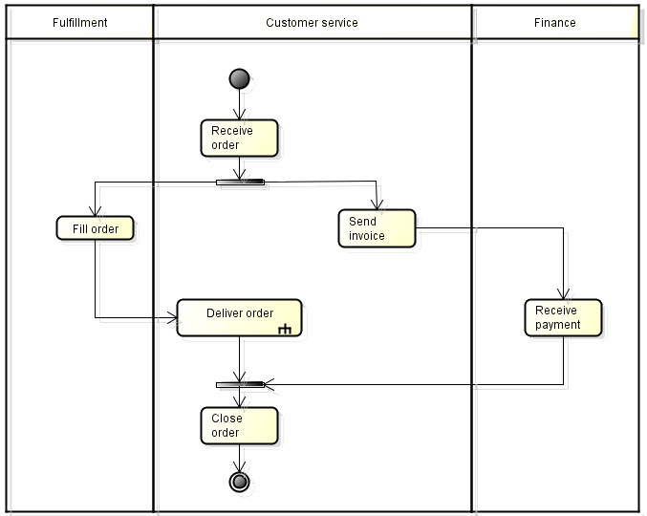
Activity diagram (5)
Partitions
Notes:
Partition help to show who do which action.

Slide 30
Sequence diagram(1)
A sequence diagram is an interaction diagram that shows how processes operate with one another and in what order.
A sequence diagram captures the behavior of a single scenario.
Sequence diagram emphasis on time sequence of messages.
Notes:
Sequence diagrams show the interaction by showing each participant with a lifeline that runs vertically down the page and the ordering of messages by reading down the page.

Slide 31
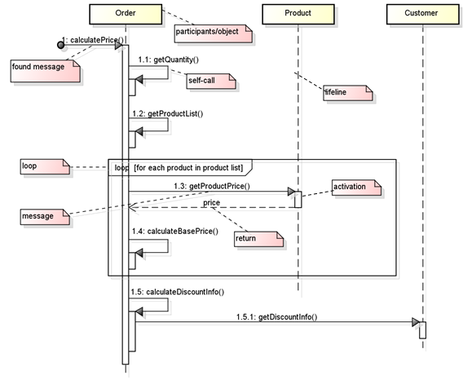
Sequence diagram(2)
An example of sequence message
Notes:
- Messages, written with horizontal arrows with the message name written above them, display interaction. Solid arrow heads represent synchronous calls, open arrow heads represent asynchronous messages, and dashed lines represent reply messages
- Found message is the first message that doesn't have a participant that sent it, as it comes from an undetermined source
Participants/objects: Object, class, entity, actor, etc…
- Self-call: the object invokes the method ifself.
- Activation bar that shows when the participants is activated in the interaction.

Slide 32
Participants/objects: Object, class, entity, actor, etc…
Messages display interaction
Synchronous message
Asynchronous message
Activation boxes represent that processes are being performed in response to the message.
Found message is message called from outside.
Self-call represents object calling method on itself.
Return means reply message
Notes:
Synchronous message is represented by horizontal line with solid arrow -> If a caller sends a synchronous message, it must wait until the message is done, such as invoking a subroutine.
Asynchronous message is represented by horizontal line with open arrow -> If a caller sends an asynchronous message, it can continue processing and doesn’t have to wait for a response.
Activation boxes, or method-call boxes, are opaque rectangles drawn on top of lifelines to represent that processes are being performed in response to the message

Slide 33
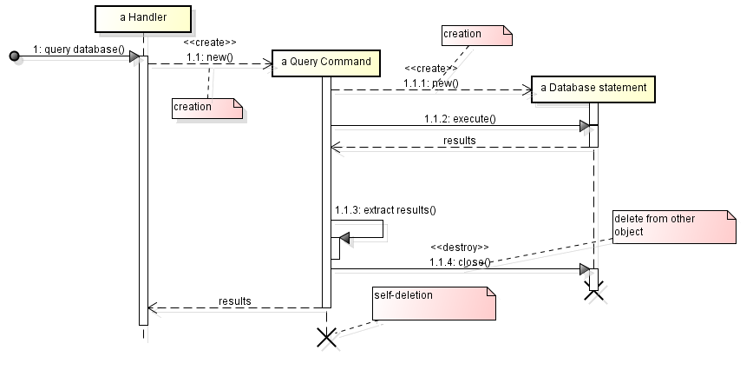
Sequence diagram(3)
Create and delete participants
Notes:
To create a participant, you draw the message arrow directly into the participant box. A message name is optional here if you are using a constructor, but I usually mark it with "new" in any case. If the participant immediately does something once it's created, such as the query command, you start an activation right after the participant box.
Deletion of a participant is indicated by big X. A message arrow going into the X indicates one participant explicitly deleting another; an X at the end of a lifeline shows a participant deleting itself.

Slide 34
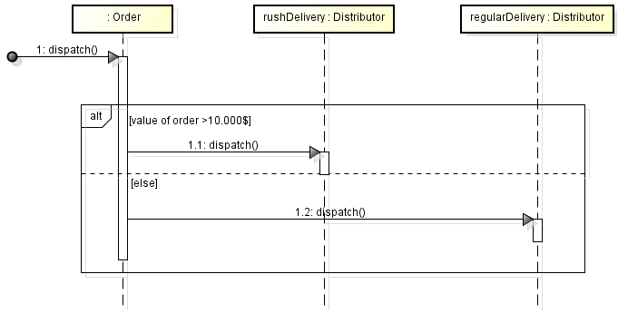
Sequence diagram(4)
Combined Fragment
Notes:
Loop: Refer to the first example

Slide 35
Sequence diagram(5)
Combined Fragment
alt: Alternative multiple fragments; only the one whose condition is true will execute (if-else)
opt :Optional; the fragment executes only if the supplied condition is true. Equivalent to an alt with only one trace (if without else)
loop: Critical region; the fragment can have only one thread executing it at once.

Slide 36
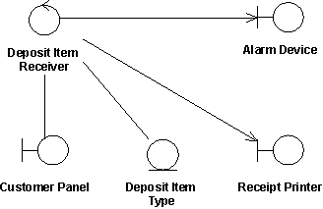
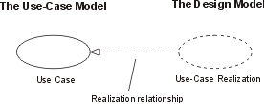
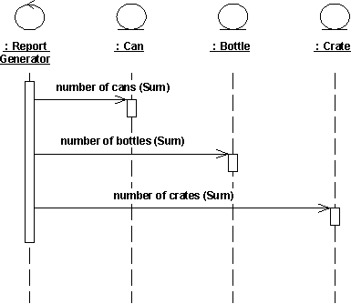
Use case realization
Use-case realization represents how a use case will be implemented in terms of collaborating objects
For each use case in the use-case model, there can be a use-case realization in the analysis/design model with a realization relationship to the use case
It may include:
A textual description (a document),
One or more class diagrams of participating classes and subsystems.
One or more Interaction diagrams (communication and sequence diagrams)

Slide 37
Use case realization Example
Class diagram – Analysis stereotype
At analysis stage
Boundary class-
Handle the communication between actors and system internal components
Entity class
Model for information handled by system and behavior associated with information
Control class
Handle the flow of control for a use case

Slide 38
Resources & references
Resources
http://en.wikipedia.org/wiki/Unified_Modeling_Language
Technical CD in Rational Rose software
EAExample.eap (EA 8.0)
Recommended readings
The unified modeling language reference manual
UML Tools:
Enterprise Architect (EA - http://www.sparxsystems.com.au/)
Visio
Rational Rose
Astah: http://astah.net/editions/community
StarUML

Slide 39


